Slide 1

GOKARAJU RANGARAJU INSTITUTE OF ENGINEERING AND TECHNOLOGY Department of Information Technology Realtime Research Project
Digital Gastronomy : Crafting an Immersive Restaurant Experience
Through Responsive Web Design and Interactive Technologies
Batch : A-6
Team Members:
R Joel Nishanth(22241A1248)
K Sai Nikhil (22241A1250)
B Rajashekar (22241A1206)
Under the Esteemed Guidance of
Dr R V S S S Nagini
(Assoc.Professor)

Slide 2
Contents
Title slide
Abstract
Tools Stack
Implementation details
Project model/ Architecture/ Prototype
Conclusion
References

Slide 3
Abstract
This project proposes the development of a Responsive Restaurant Website, leveraging HTML, CSS, and JavaScript technologies to create an engaging and accessible online platform for restaurant management and customer interaction. The restaurant website features an intuitive and visually appealing interface, ensuring a seamless browsing experience for users. The design prioritizes easy navigation, allowing visitors to quickly find menus, make reservations, and access contact information. The site showcases the restaurant's menu with high-quality images, detailed descriptions, and pricing information. It includes options for knowing bestsellers, ensuring that customers can easily explore and choose their favorite dishes. Through analyzing user feedback and behavioral patterns, the system adapts recommendations in real-time, fostering deeper connections and satisfaction. The website includes features for customer reviews and feedback, promoting engagement and community interaction. Additionally, it provides updates on menu, bestsellers, keeping customers informed and connected to the restaurant's latest offerings.

Slide 4
Tools Stack
HTML: Defines the structure and content layout of different sections across the website.
HTML5:Specifies semantic elements(‘<header>’,<section>’,’<footer>’)to organize content.
CSS STYLING: Enhances visual presentation and ensures consistent styling across various devices and screen sizes.
CSS: Applies styles defined in ‘styles.css’ to format fonts, colors, margins and positioning.
JAVA SCRIPT FOR INTERACTIVITY: Adds interactive behavior to the website, enhancing user experience and functionality.
JavaScript: Includes ‘script.js’ for implementing features like toggling mobile menu visibility.

Slide 5
Implementation Details
The front-end of the restaurant website is built using HTML, CSS, and JavaScript, ensuring a visually appealing and user-friendly interface. HTML5 is employed to structure the web pages with semantic elements such as <header>, <nav>, <section>, <article>, and <footer>. CSS, along with Sass for advanced pre-processing, is used to style these elements, maintaining a consistent and modern design across the site. To enhance interactivity, JavaScript is integrated, allowing for dynamic updates and responses to user actions.
Our website consists of totally 6 pages(Home, About Us, Bestseller, Menu, Feedback, Book a table) which can be accessed through the header in the home page. We can navigate throughout the website only by the help of the header, which makes the interface easy for the users. We can also book a table in this website and it also provides the feature for the feedback from the customers.
Finally, we can conclude that, our restaurant website implements a responsive design using HTML, CSS, and JavaScript, enabling seamless navigation with a clear menu structure. It features engaging content including an about section, bestsellers showcase, detailed menu options, customer feedback, and a booking system for table reservations.

Slide 6
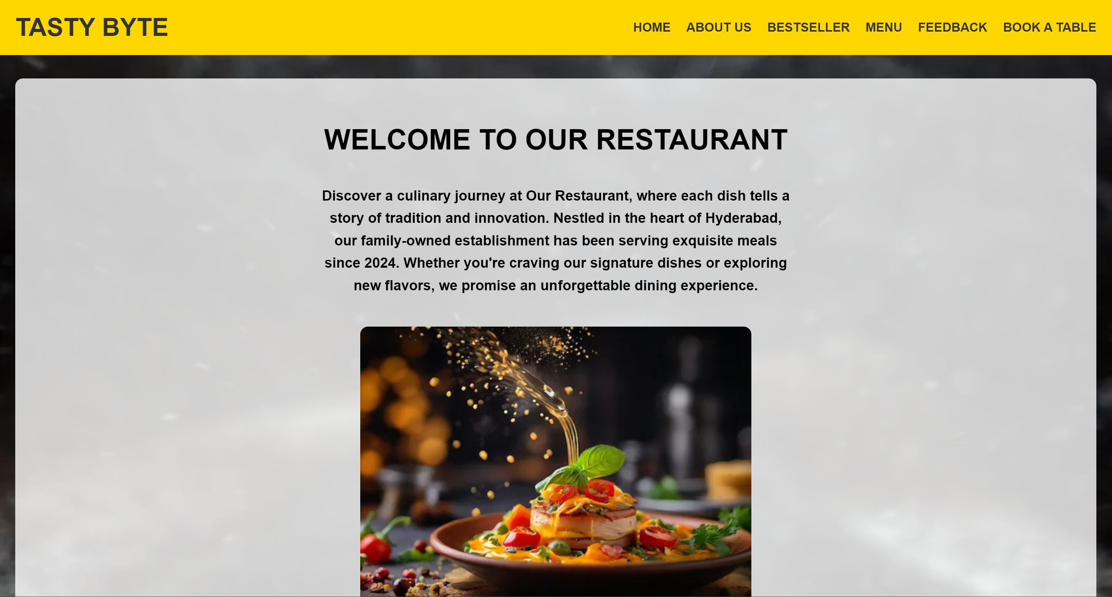
Prototype

Slide 7
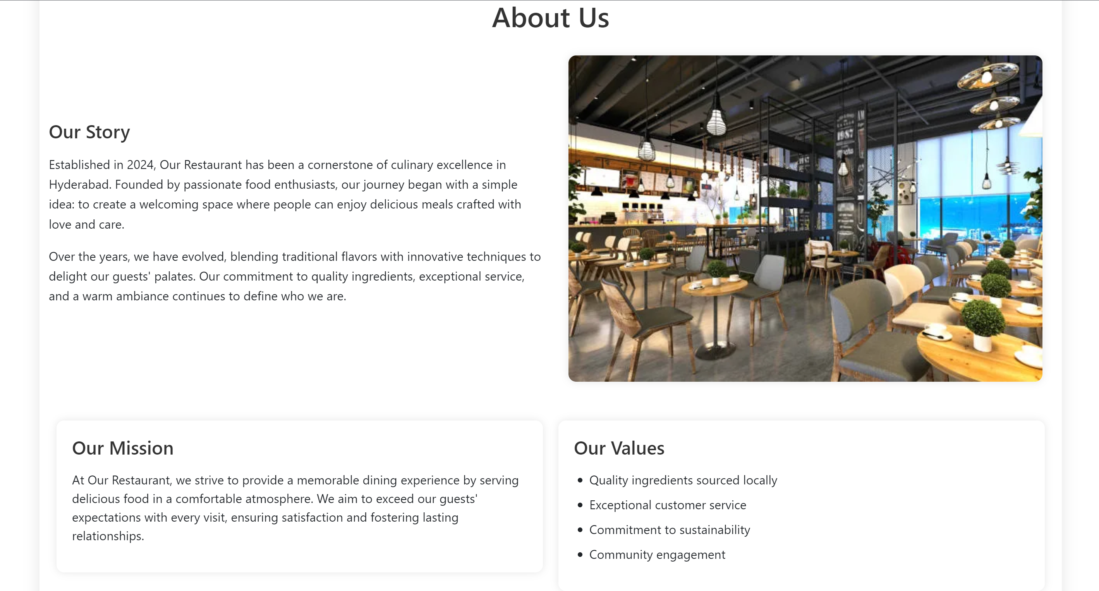
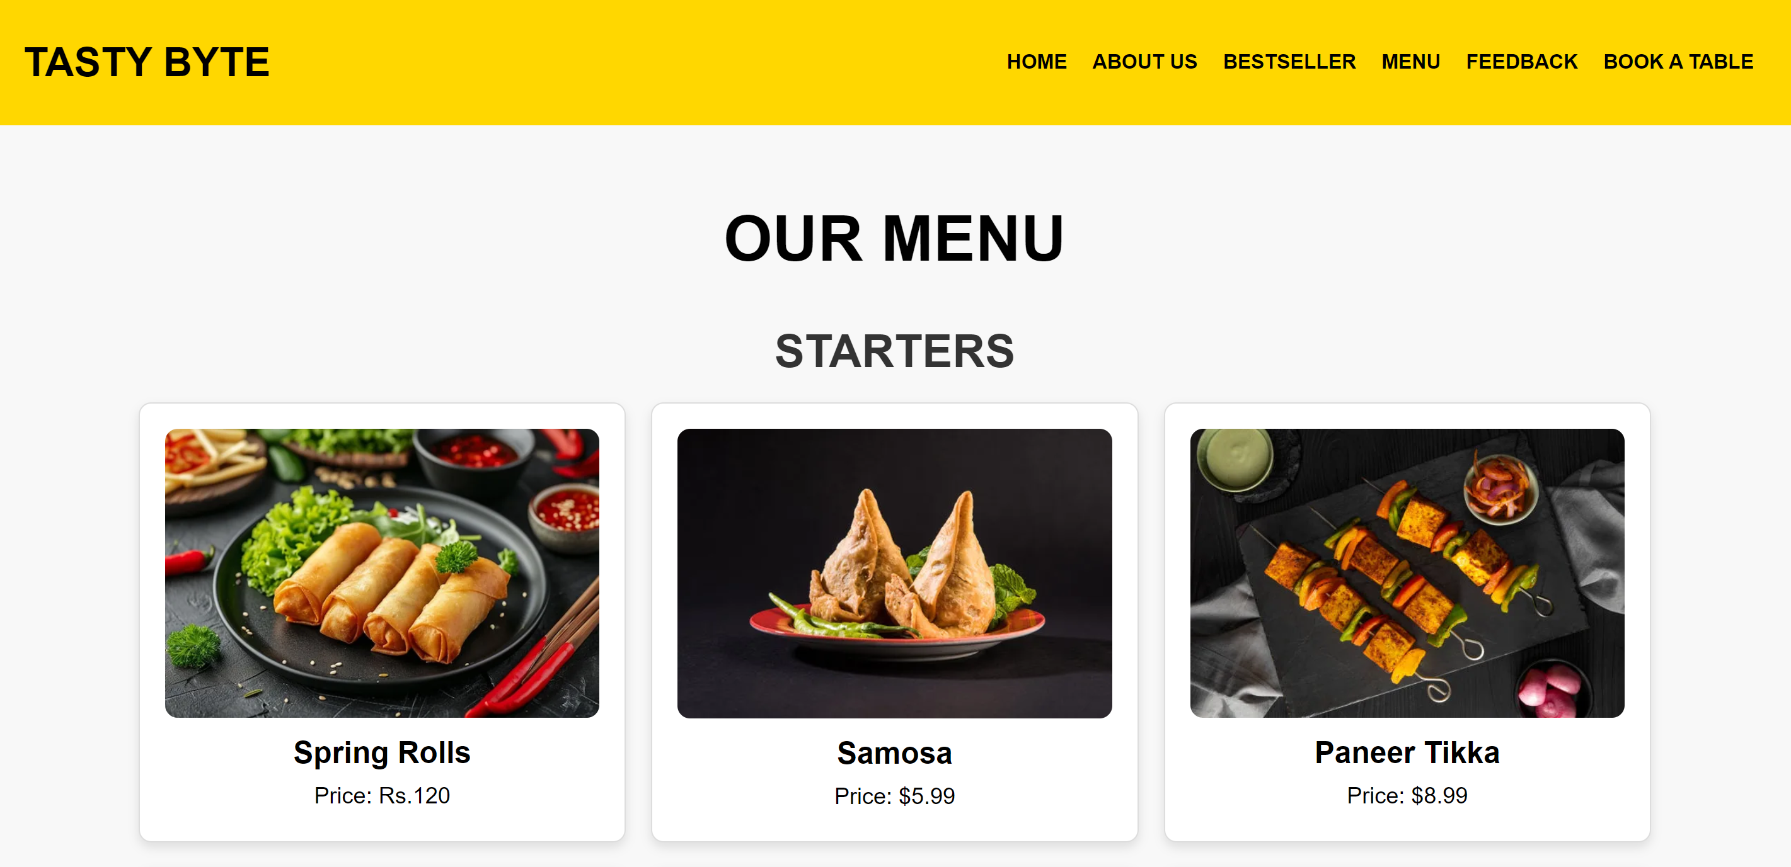
About Us Page
Our Menu Page

Slide 8
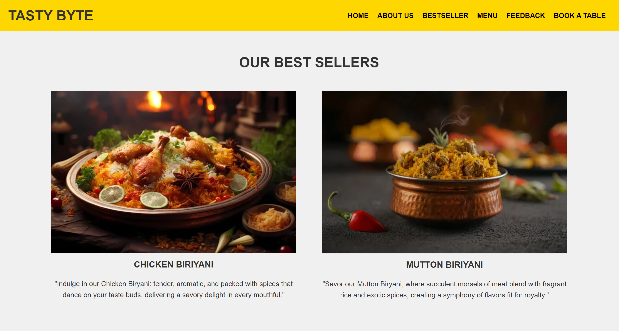
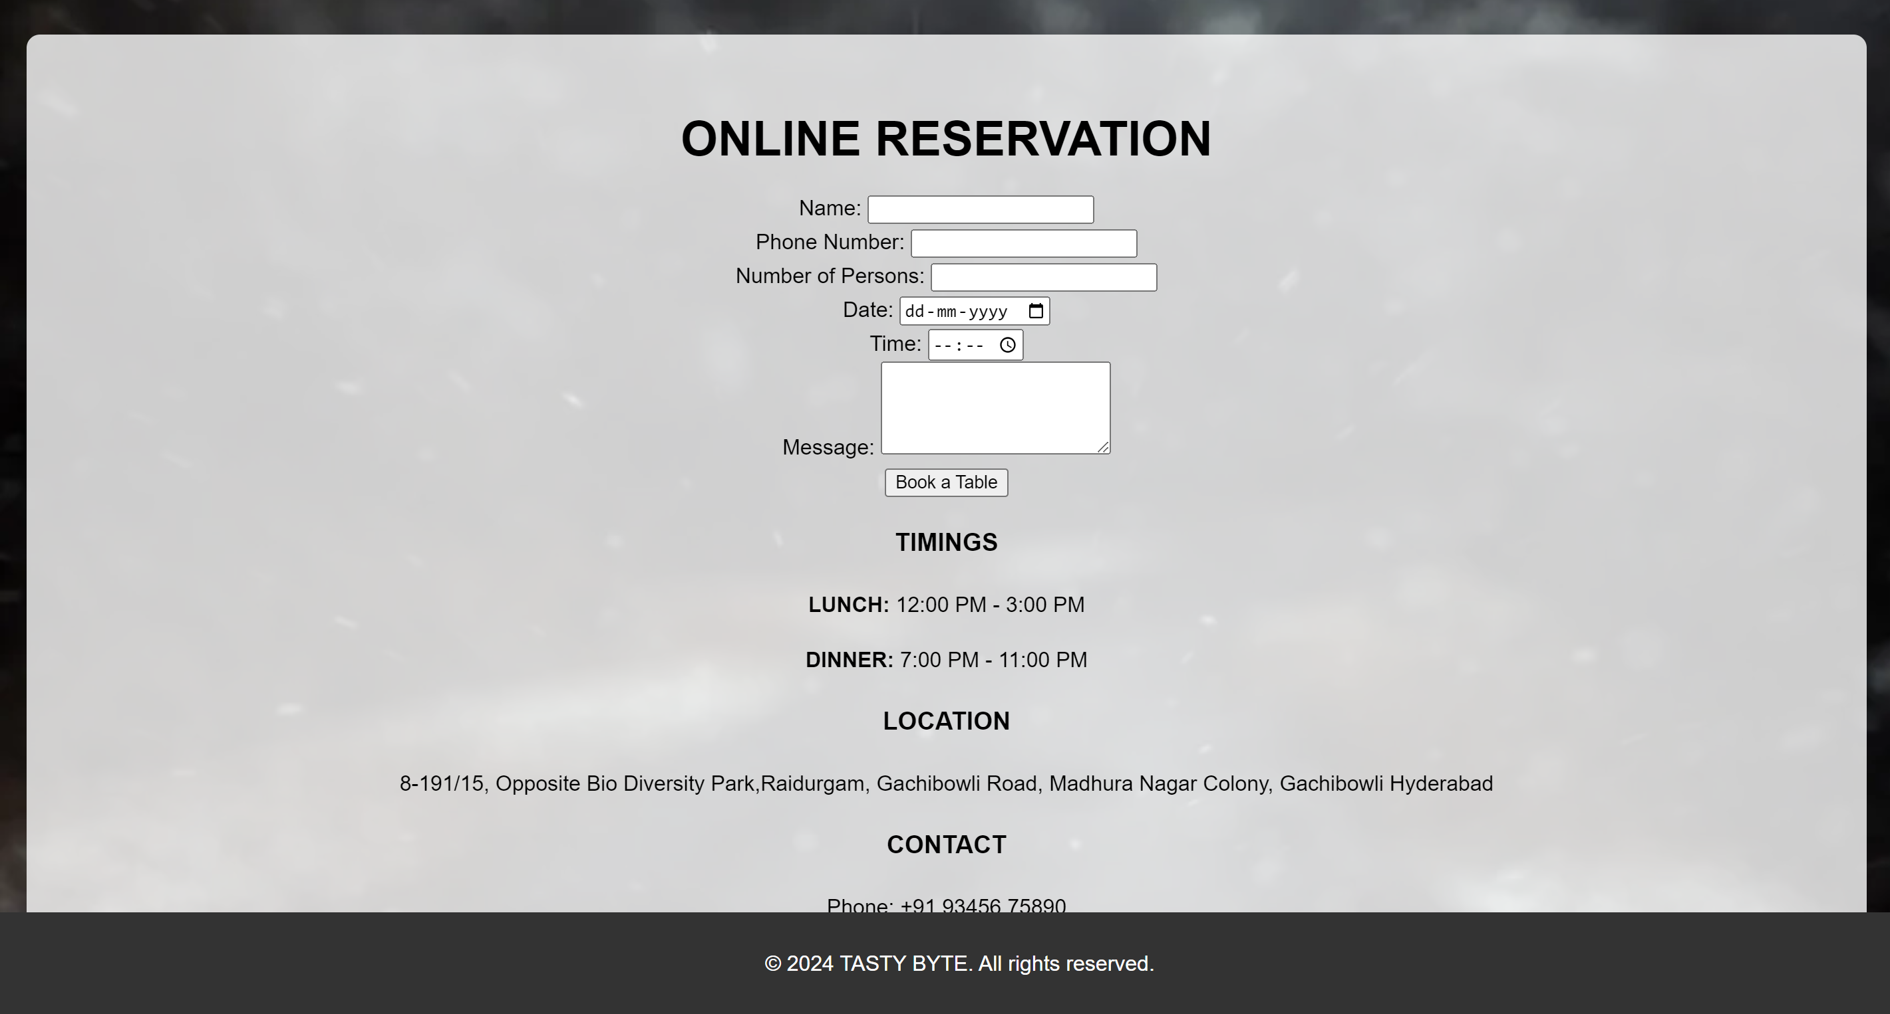
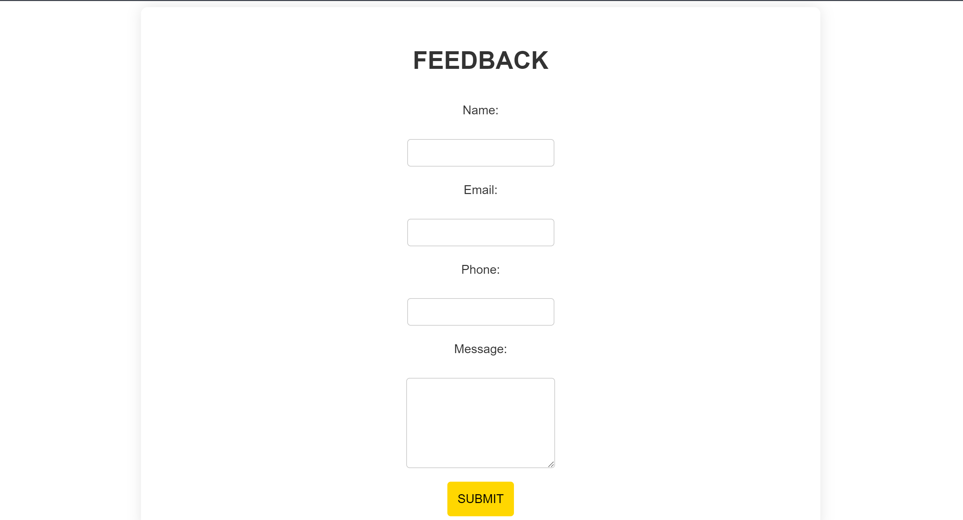
Best Sellers page
Book a Table Page
Feedback Page

Slide 9
Conclusion
In conclusion, the development of a restaurant website involves a comprehensive approach that integrates various technologies and tools to create a robust, user-friendly, and dynamic online presence.
By utilizing HTML, CSS, JavaScript for the front-end, we ensure a visually appealing and responsive user interface. Through clear navigation and interactive features, customers can easily explore our offerings, learn about our story, and make table reservations.
Overall, this project exemplifies how modern web development practices can be applied to create a sophisticated and effective online presence for a restaurant, ultimately driving business growth and enhancing customer satisfaction. This digital platform not only enhances our customer experience but also streamlines our operations, paving the way for future growth and success.

Slide 10
References
https://github.com/topics/restaurant-website
https://www.w3schools.com/howto/howto_website_restaurant.asp
https://www.behance.net/search/projects/Restaurant%20Website

Slide 11

THANK YOU
Any Queries

